Slide 1
Southern African Food Systems Building a Research Community based on Stakeholder Dialogue

Slide 2
Trends and drivers of change in southern African food systems
Urbanisation
Changing food preferences and consumption behaviour
Increasing NCDs
Emerging business opportunities
Land and agrarian reform
Climate variability and other environmental stressors including water stress
…

Slide 3
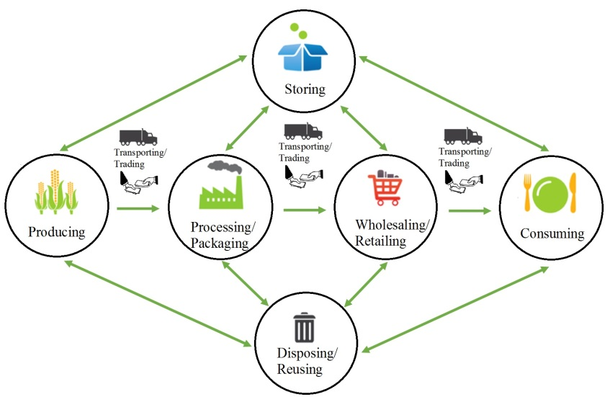
Food Systems include a set of ‘Activities’ …
Notes:
Set of activities
Land use change under production but feedback

Slide 4
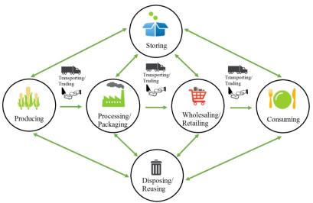
… all of which lead to a number of ‘Outcomes’
Food System OUTCOMES Contributing to:
Social Welfare
Income
Health
Wealth
Social capital
Political capital
Human capital
Food Security
Availability
Access
Utilisation
Environmental
Conditions
Land use
Water use
Biodiversity
Soil degradation
GHG emissions

Slide 5
Key Question and Interested Parties
Science Agencies
Resource Managers
Business Managers
Policy Makers
Development Agencies
e.g.
NRF,
ICSU-Africa
improved GEC/food security science
e.g.
farmers, range conservation NGOs
improved food security & nat resource mgmt
e.g.
purchasers, processors, retailers
improved food system efficiency & sustainability
e.g.
SADC, national ministers
improved food security & env policies
e.g.
USAID, FAO,
CARE
improved livelihoods & reduced vulnerability
How would different food system governance arrangements affect food security and land use in Southern Africa?
Natural Scientists
Science Questions
Social Scientists
e.g.
agronomy
regional hydrology
land degradation
biodiversity loss
climate change
e.g.
markets and trade
resource tenure
institutions
governance
social capital
Notes:
Core Q which has a wide range od communities interested in it but for different reasons… we want to talk to everyone on the slide- esp ILSI and resource managers…
We recognise that these different stakeholders all have different worldviews and we believe that ILSI SA could have interests in answering this core Q so what we want to do is to elicit the specific Qs of interest to the ILSI community from their point of view..

Slide 6
Recognising that …
Importance of private companies in food security and land use issues is growing.
Demand from large purchasers drives production.

Slide 7
SAFGOV project objectives
To build an community of research skills, closely linked to a range of stakeholders across southern Africa’s public and private organisations
that can
Co-design and jointly undertake research on how to improve Southern African food system activities and enterprises to enhance food security and land use outcomes in the face of future challenges.

Slide 8
Background
Importance of private companies in food security and land use issues is growing.
Especially in how demand from large purchasers drives production
Governance arrangements among these actors are poorly understood, especially in terms of environmental impacts and food security outcomes

Slide 9
SAFGOV Conceptual Model
Health Sector
Consumers
Demand Signal
Material
Food Sec Agencies
Government
Civil Society
Value Chain
Nat Resource Agencies
Demand Signal
Material
Producers
Input suppliers

Slide 10
SAFGOV Workshop 1 (October, NRF): Key Points
Three main issues were identified for defining boundaries of study:
Focus on maize vs focus on wider food system?
Quality of diet is key for food security so focusing on maize alone may not be of the greatest interest to food security agencies.
Recognised that maize had been identified as a case study for a more substantial research project on regional food security so questions should also be thought of in terms of the whole food system.
South Africa or Southern Africa?
Issues in South Africa relate more to conversion of arable land to e.g. game parks or mining.
On a regional basis the overarching issue is conversion of native vegetation to arable.
Near term (multi-season) or long term (multi-decade)?
2030

Slide 11
SAFGOV Proposed Boundaries
Consumers
Health Sector
Demand Signal
Material
Food Sec Agencies
Government
Civil Society
Value Chain
Demand Signal
Nat Resource Agencies
Material
Producers
Input suppliers
What: impact on landuse of chicken (“transition” meat; indirect impact through feed); maize (direct landuse); dairy (indirect landuse through feed and direct landuse through grazing); all important for food security.
Where: South Africa, Angola, Zambia & Zimbabwe : four different governance systems and potential landuse changes due to climate change.

Slide 12
SAFGOV project objectives
To build an community of research skills, closely linked to a range of stakeholders across southern Africa’s public and private organisations
that can
Co-design and jointly undertake research on how to improve Southern African food system activities and enterprises to enhance food security and land use outcomes in the face of future challenges.

Slide 13
Recognising…
Importance of private companies in food security and land use issues is growing.
Especially in how demand from large purchasers drives production
Governance arrangements among these actors are poorly understood, especially in terms of environmental impacts and food security outcomes

Slide 14
SAFGOV Next Steps
Main aspects of future research proposal
clear set of researchable Qs based on s/holder information need
develop scenarios based on main uncertainties
Undertake analyses of food sec and LU options futures within each scenario
Different stakeholder roles?
collaborative rather than merely consultative
being part of discrete work packages as well as the whole…
identifying potential co-funders and helping champion project
other roles?

Slide 15
SAFGOV Next Steps
Need to establish how we will continue to work together as a virtual team
Importance of knowledge management and information sharing “platform” as a way to support this:
place to develop a proposal
a lot of uses for KM
benefits for stakeholders who become our research partners

Slide 16
SAFGOV Next Steps
Next steps and actions
Who else do we need to invite at this stage?. E.g. Centre of Excellence on Food Security (U Pretoria & UWC)?
Joint development of a proposal, to include
Stmt on ethics and IP
Roles of participants in (i) proposal prep and (ii) project delivery

